Slide 1
Managing Digital Assets
Museums and Intellectual Property

Slide 2

What is Intellectual Property?
Intellectual Property Rights
™
©
licensing
patent

Slide 3
What can be considered IP?
Factual data cannot; so most data associated with specimens is covered
However, associated media, analyses, and even techniques (think specimen processing) can be

Slide 4
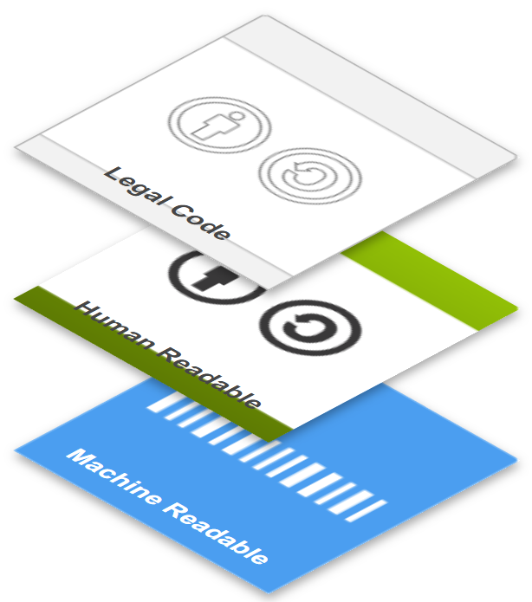
Creative commons- a useful tool
An easy way for anyone to create a license that grants access to IP under conditions
The conditions determine the type of license
Each license has 3 layers
legal jargon (the actual agreement)
description that non lawyerly people can understand
a bit of code (html) that you embed in a webpage

Slide 5
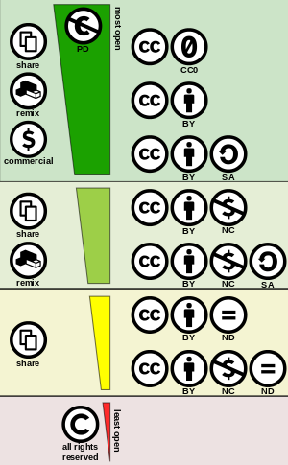
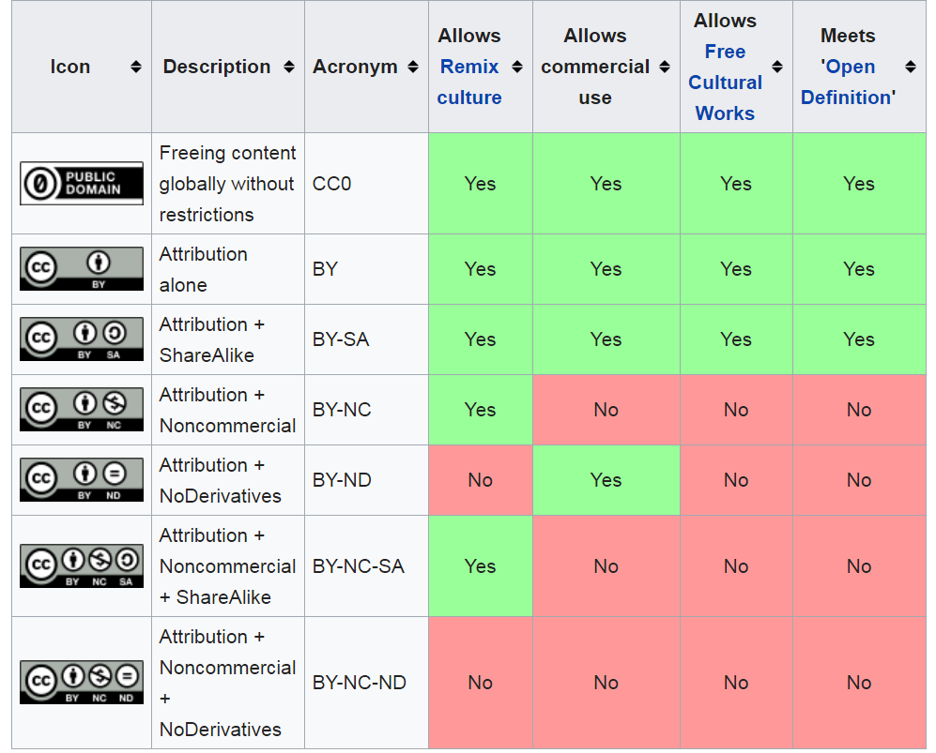
Types of CC Licenses
To choose a license: https://creativecommons.org/choose/

